Slide 1
Partner Asset Guidance
Surface in the Hybrid Workplace
The Surface in the Hybrid Workplace assets show how companies can get more in return with their hybrid work investments by building a secure, productive hybrid workplace with Surface for Business.
How to use the Surface in the Hybrid Workplace assets
The Surface in the Hybrid Workplace BOM include four (4) assets: an eBook; infographic, email template, and digital flyer. Each asset has white space included to make room for partner branding. CTAs can also be edited, as they currently direct the audience to the eBook download.​ The eBook will need to be hosted locally and any CTA’s will need to be updated with the new URL that points to the newly hosted eBook.
1. eBook:
Objective: Inform the audience of the value props of the Microsoft Surface for Business devices and how they can help solve the problems that arise with disparate teams to help them stay productive, collaborate together, and find new ways to work in this changing work environment. The call-to-action (CTA) leads to the Surface for Business website.
File Format: PDF
Editing tips Please use the associated AI file and edit assets in a compatible program (like InDesign).
2. Infographic:​
Objective: The infographic is designed to be used as a teaser for the eBook or as a stand-alone overview of the value props of the Microsoft Surface for Business devices, and it provides proof points to show how Microsoft Surface and Microsoft 365 (M365) support the hybrid workspace and return on investment (ROI). The CTA leads to the Surface for Business website.
File Format: PDF
Editing tips Please use the associated AI file and edit assets in a compatible program (like InDesign).
3. Email:​
Objective: The email invites the recipient to explore Microsoft Surface for Business as a means to build a hybrid workplace. It informs the audience of the value props of the Microsoft Surface and M365, and the CTA leads to the eBook and the Surface for Business website.
File Format: OFT
Editing tips To build the OFT email, choose the OFT file from the eMail Templates folder. Add the name of the recipient and your name in the introductory paragraph. Add your email address to the “Contact me” link at the bottom of the email. For the email template, edits must be made in a Microsoft Office-compatible program (like Microsoft Outlook).
4. Flyer:​
Objective: In a brief, promotional, 1-page format, the flyer informs the audience of the value props of Microsoft Surface for Business in a hybrid workplace. The CTA leads to the Surface for Business website.
File Format: PDF
Editing tips Please use the associated AI file and edit assets in a compatible program (like InDesign).
© 2021 Microsoft Corporation. All rights reserved. This document is provided “as-is.” Information and views expressed in this document, including URL and other Internet Web site references, may change without notice. You bear the risk of using it. This document does not provide you with any legal rights to any intellectual property in any Microsoft product. You may copy and use this document for your internal, reference purposes.
https://www.microsoft.com/en-us/surface/business

Slide 2
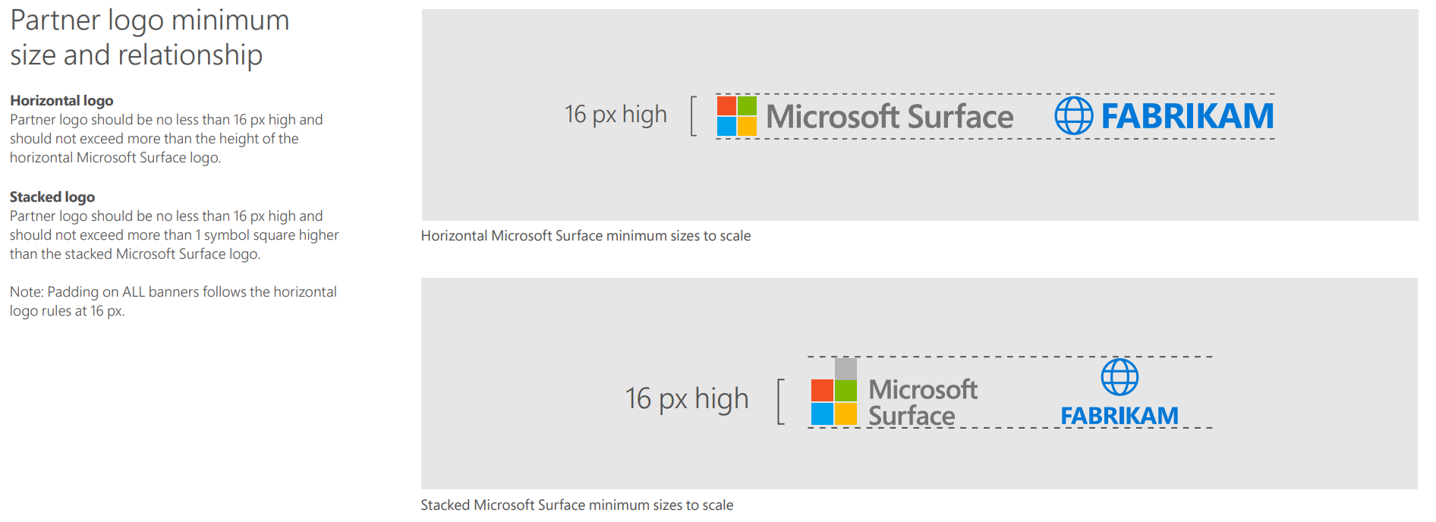
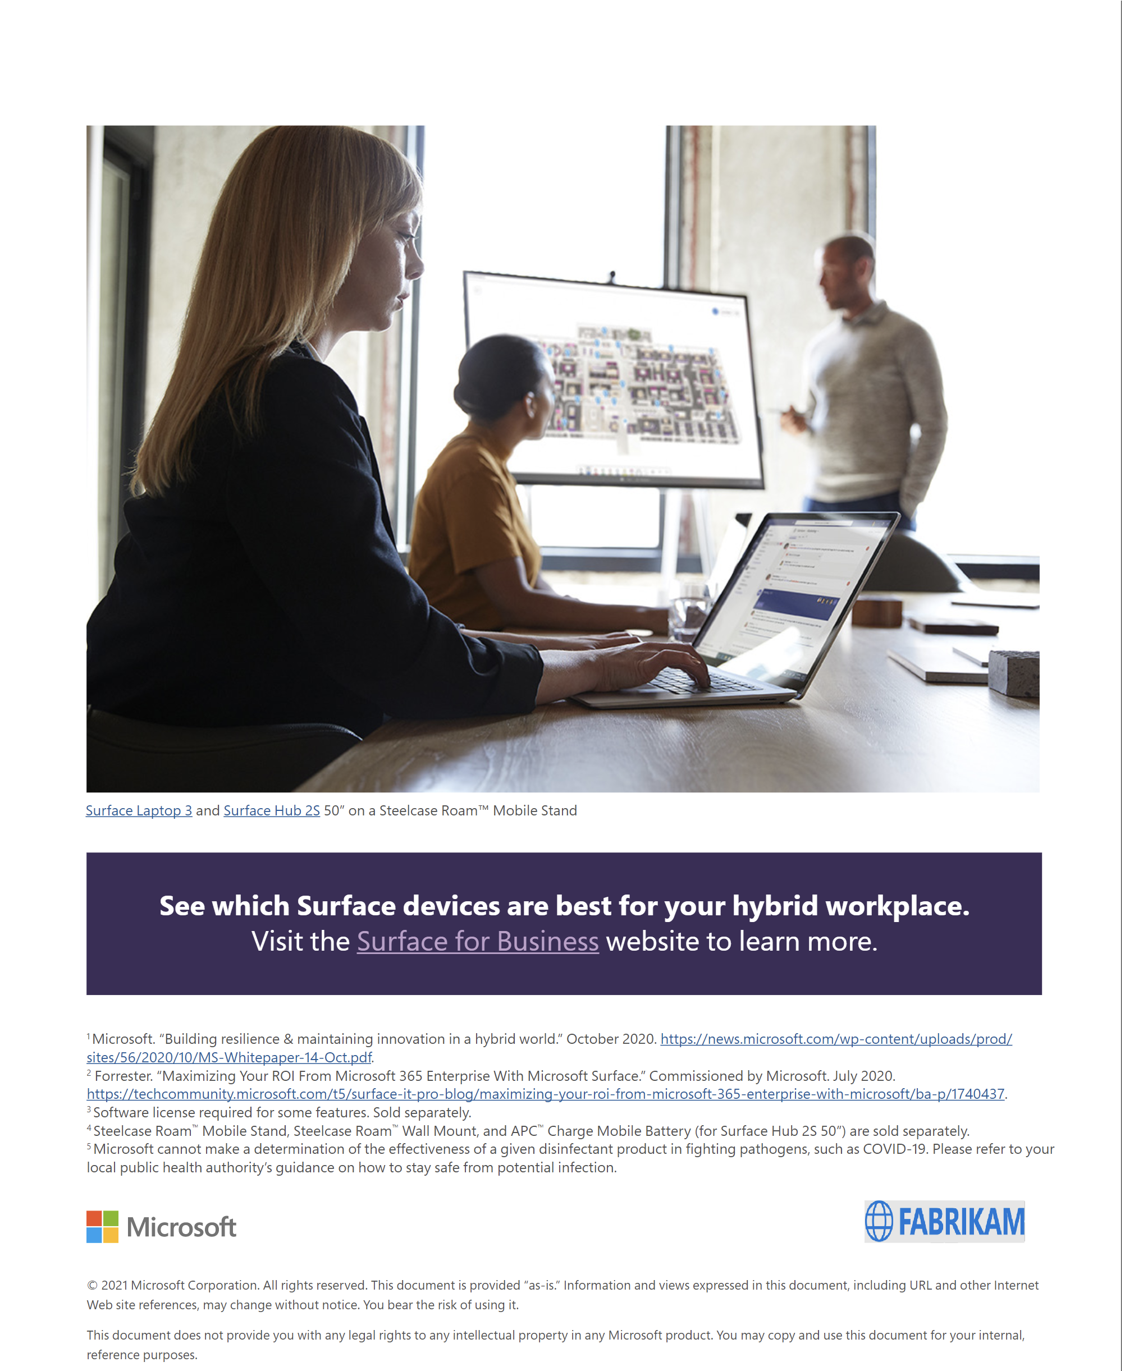
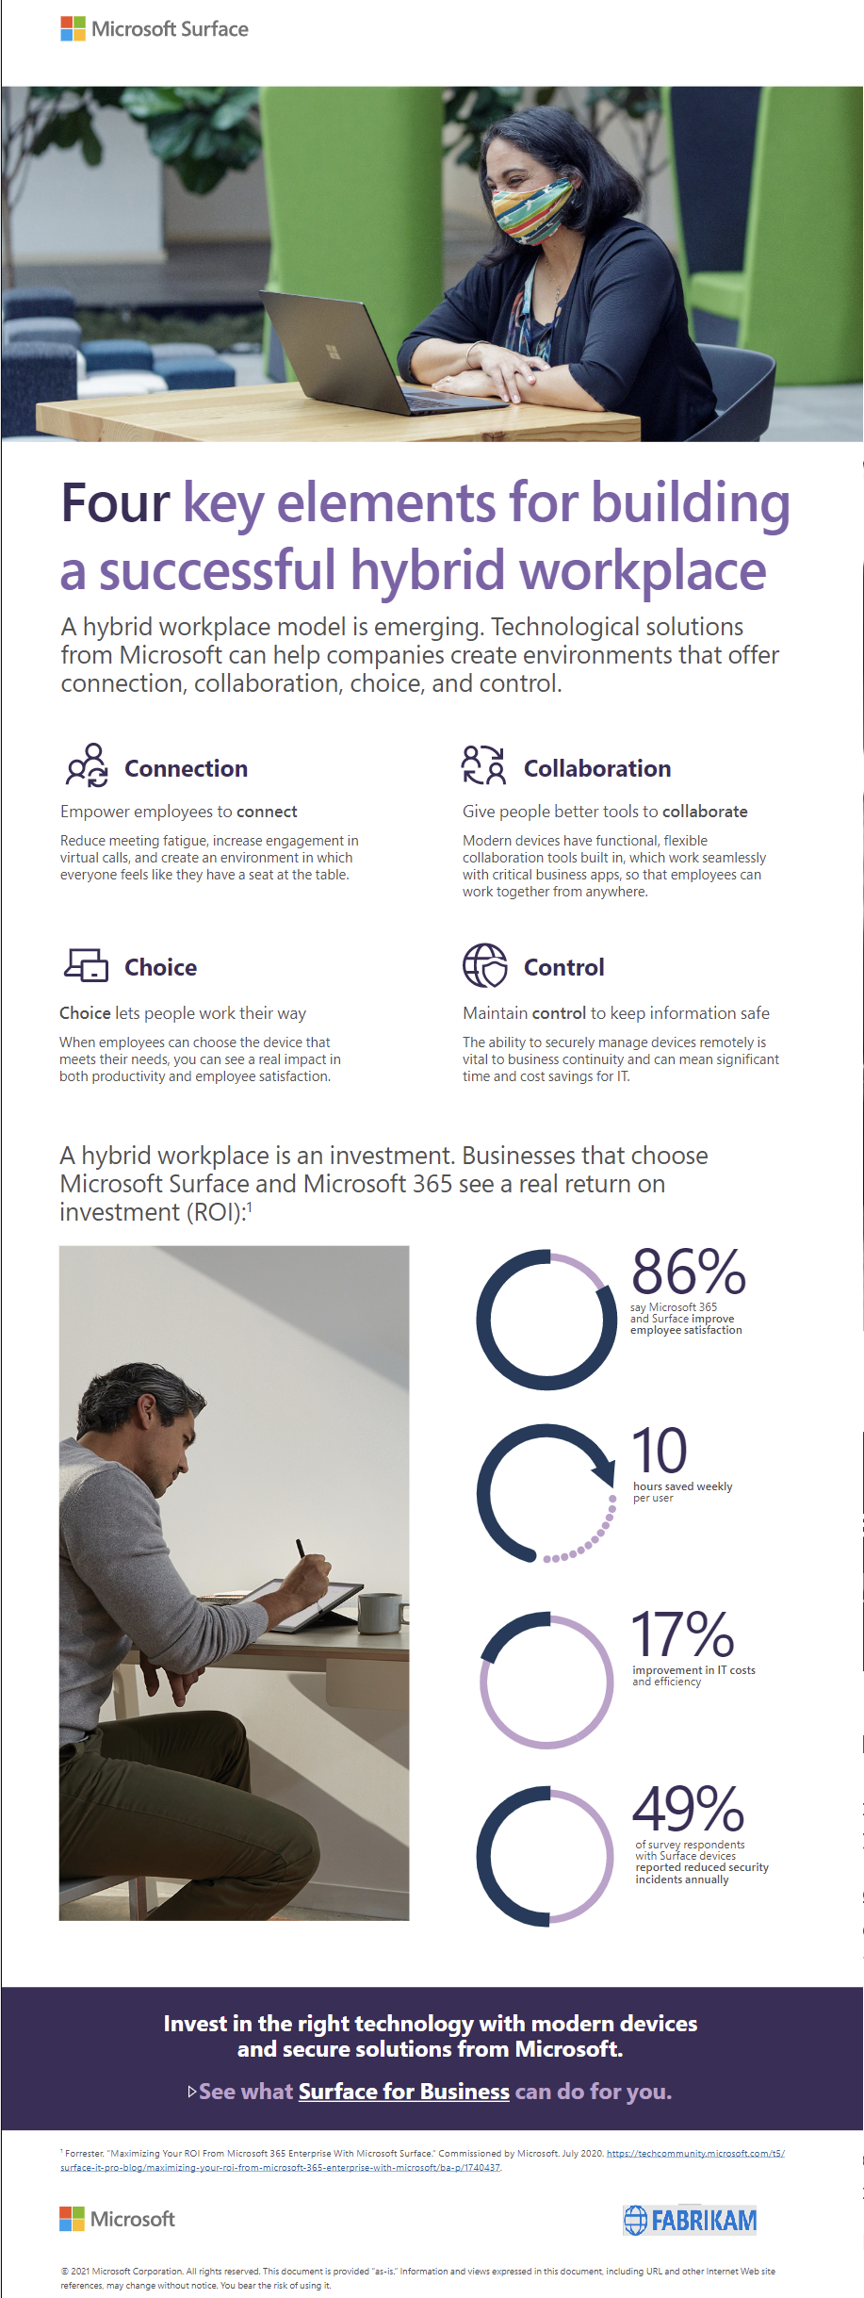
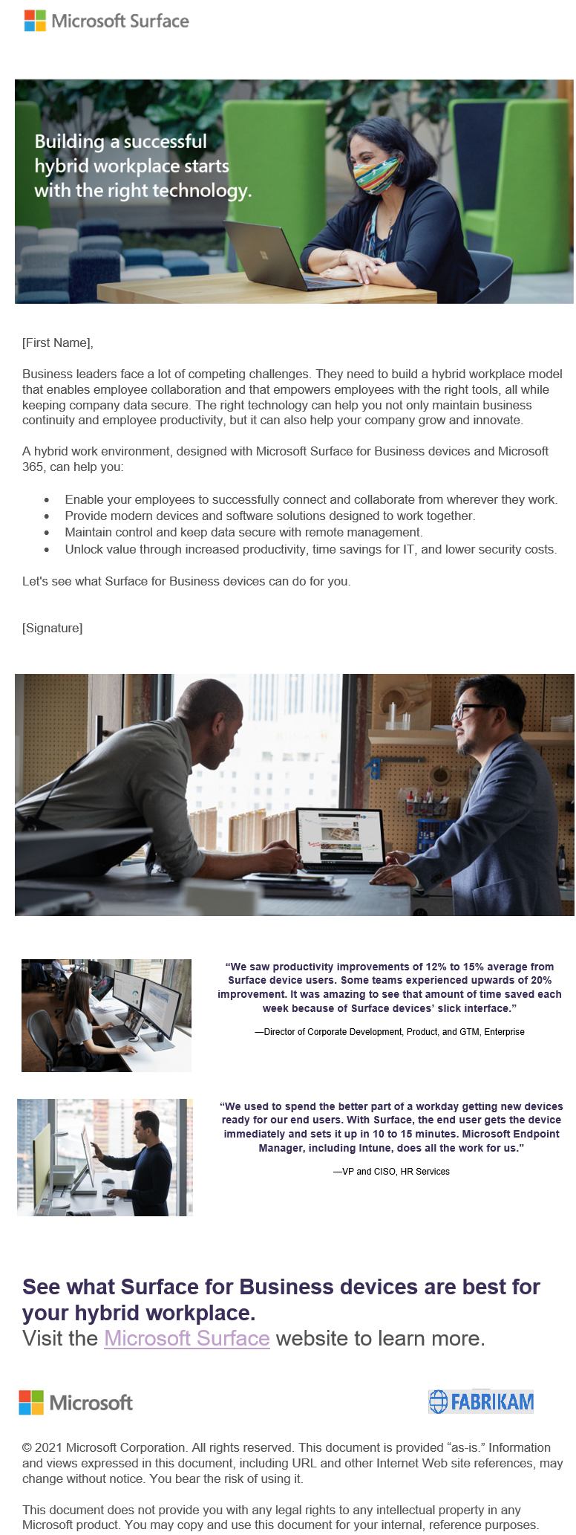
Co-branding eBooks, emails & flyers
A partner logo can be added to the bottom left corner each asset using the guidelines below.
Shown for example only
eBook
infographic
email

